Slide 1
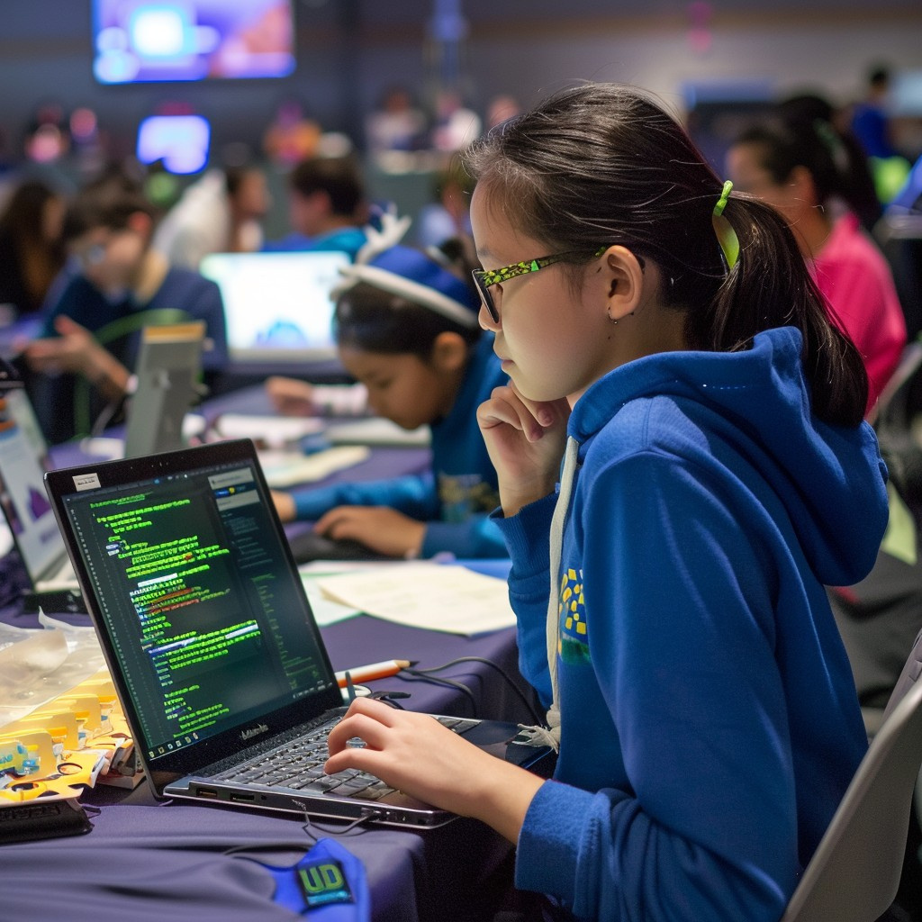


UNIV
Making Universities Social
Go to APP
Go to GITHUB Repository

Slide 2

UNIV Introduction
Stay connected, informed, and engaged with UNIV, the all-in-one platform designed to enhance your college experience. Whether you're looking to join study groups, stay updated on campus events, or connect with fellow students, UNIV offers a seamless way to interact and share. With features like personalized profiles, group discussions and real-time messaging, you'll never miss out on what's happening around you. Join now and be a part of your college's vibrant community!

Slide 3

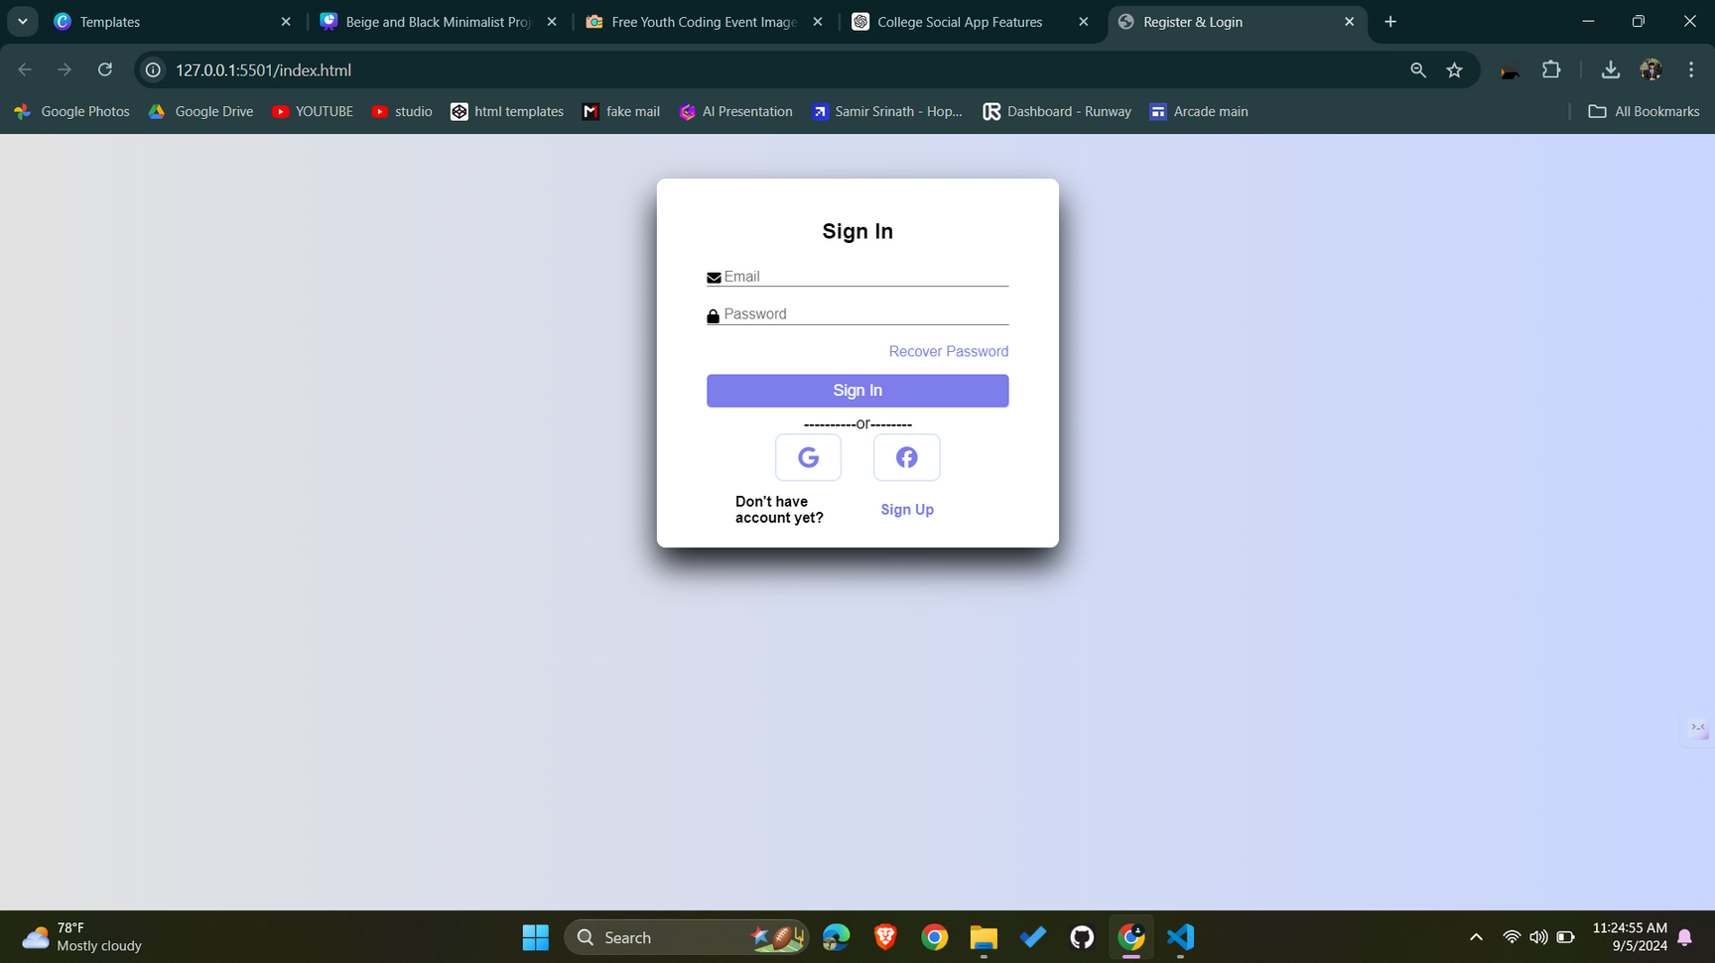
UNIV
Features
User ID
Password

Slide 4
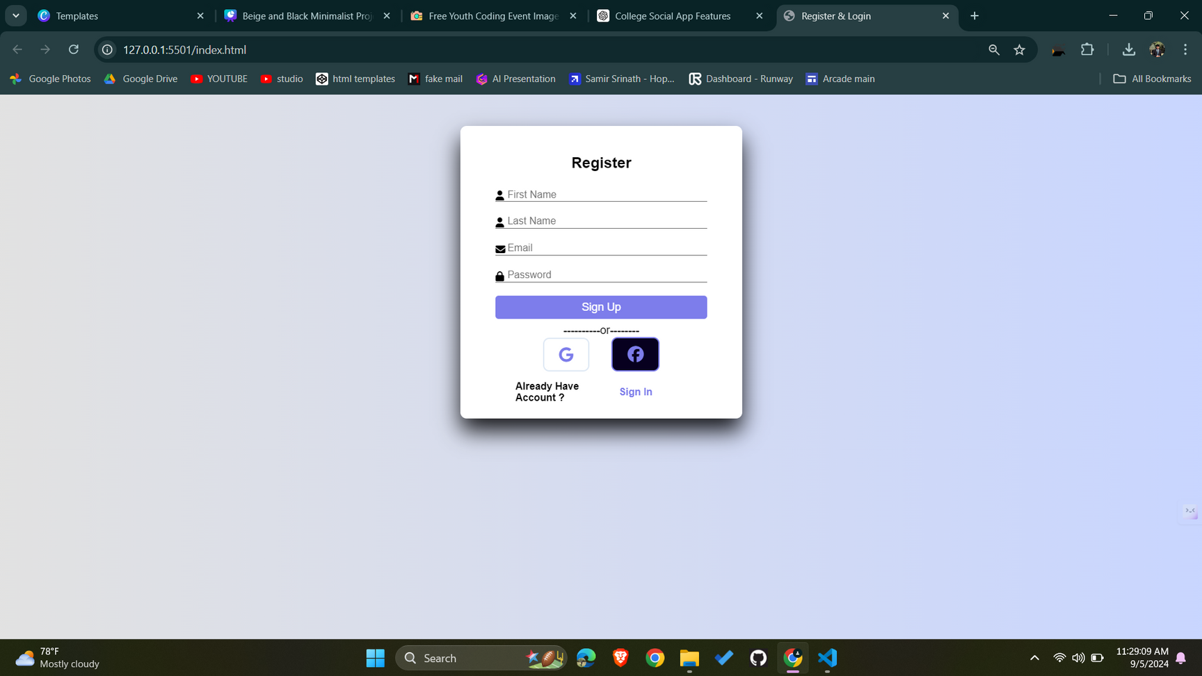
UNIV
Features
New User
can create
Account

Slide 5
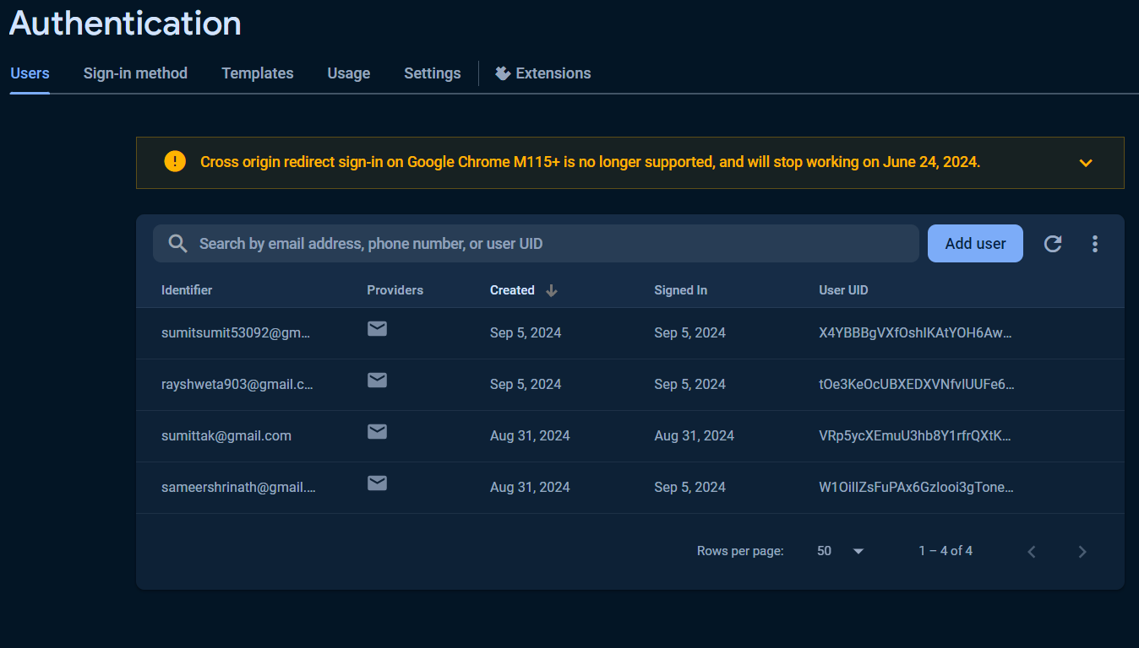
UNIV
Using Firebase DataBase
User DataBase

Slide 6
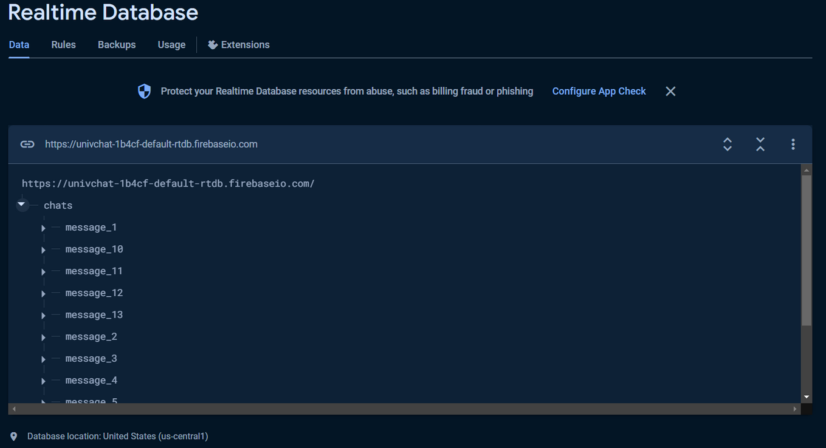
UNIV
Using Firebase DataBase
Realtime Chat
DataBase

Slide 7
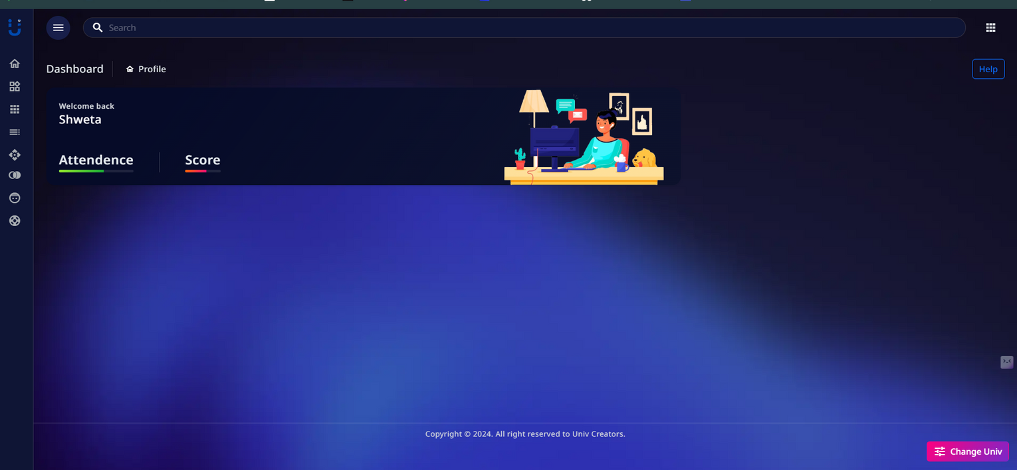
UNIV
Features
User Profile

Slide 8
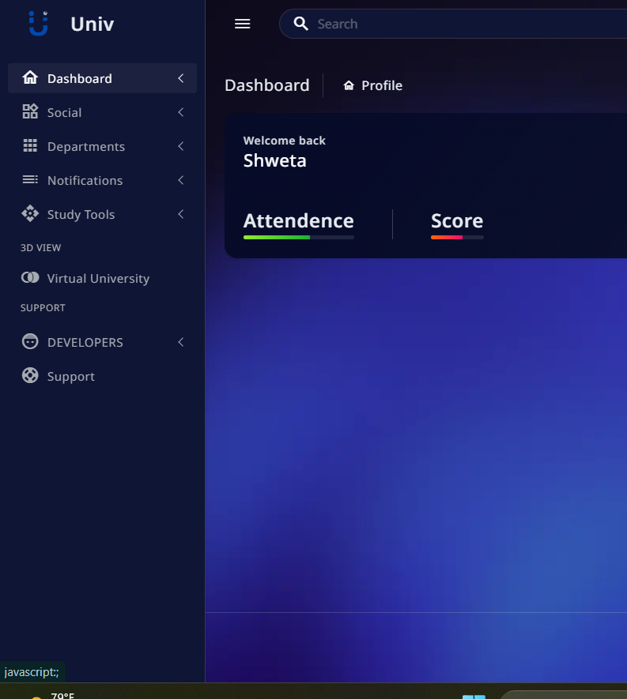
UNIV
Features
User Friendly
Navigation Button

Slide 9
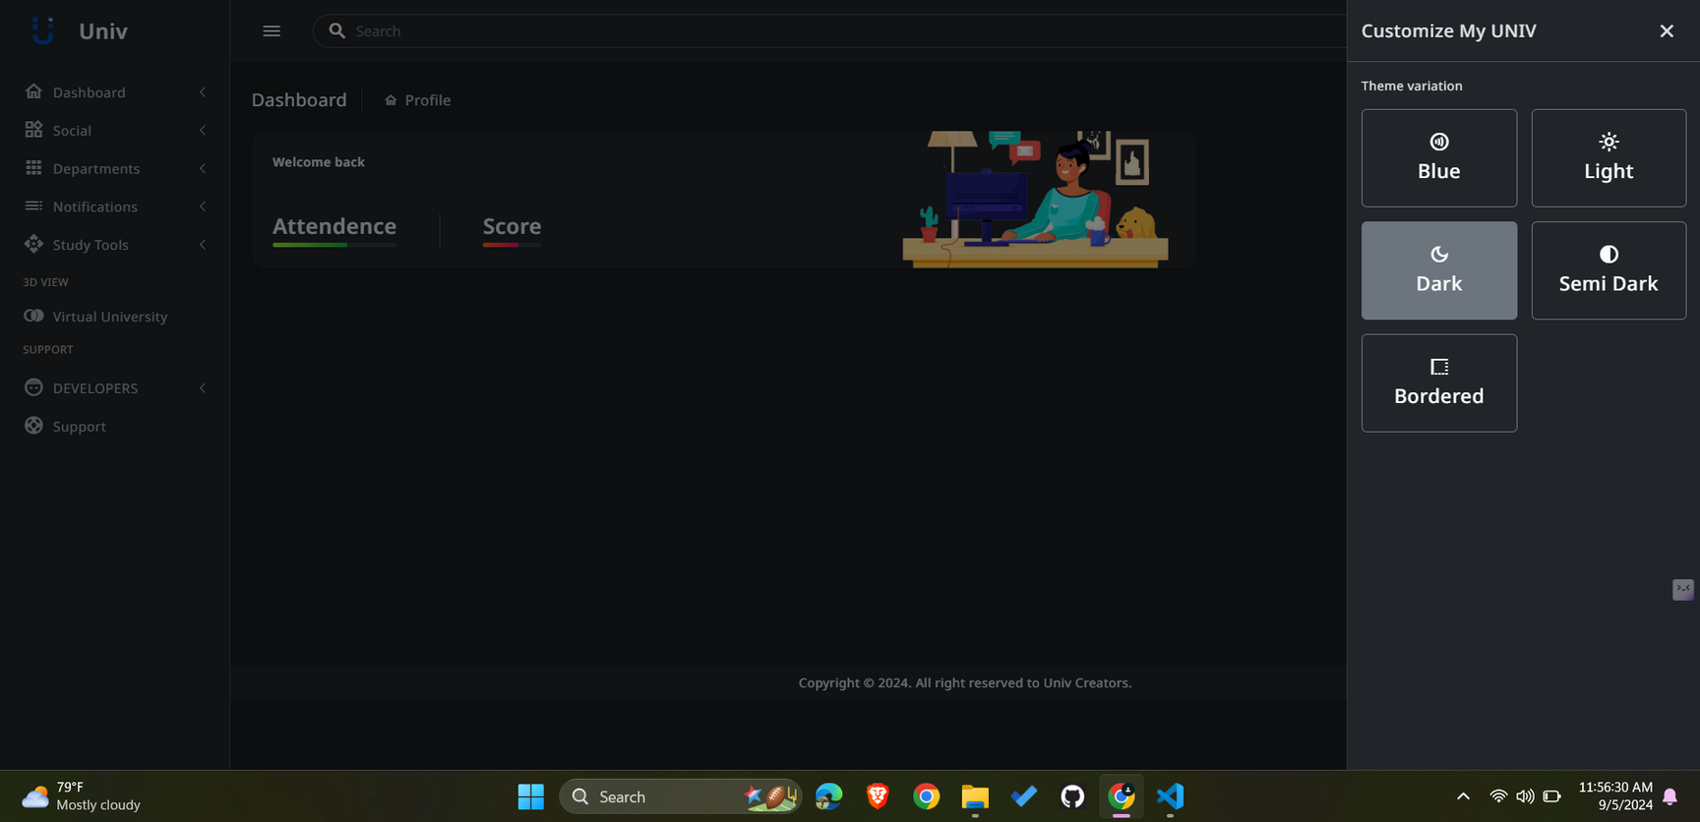
UNIV
Features
Different User Theme

Slide 10
UNIV
Features
User Friendly
Navigation Button

Slide 11
UNIV
Features
User Friendly
Navigation Button

Slide 12

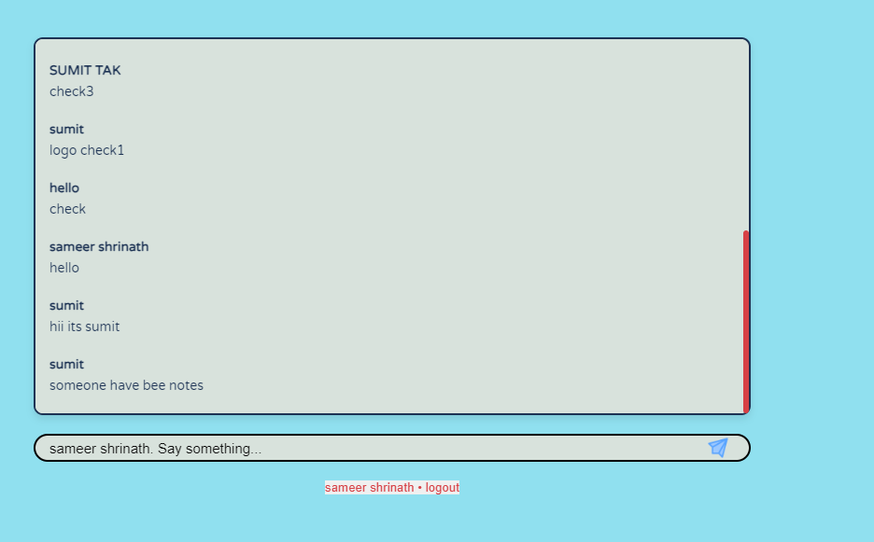
UNIV
Chat
Join the Chat
Real Time
chat window

Slide 13
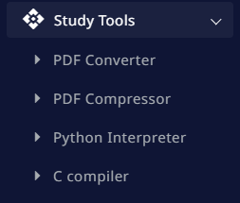
UNIV
Features
Study Tools

Slide 14
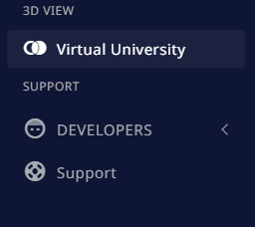
UNIV
Features
Virtual (3D) University

Slide 15



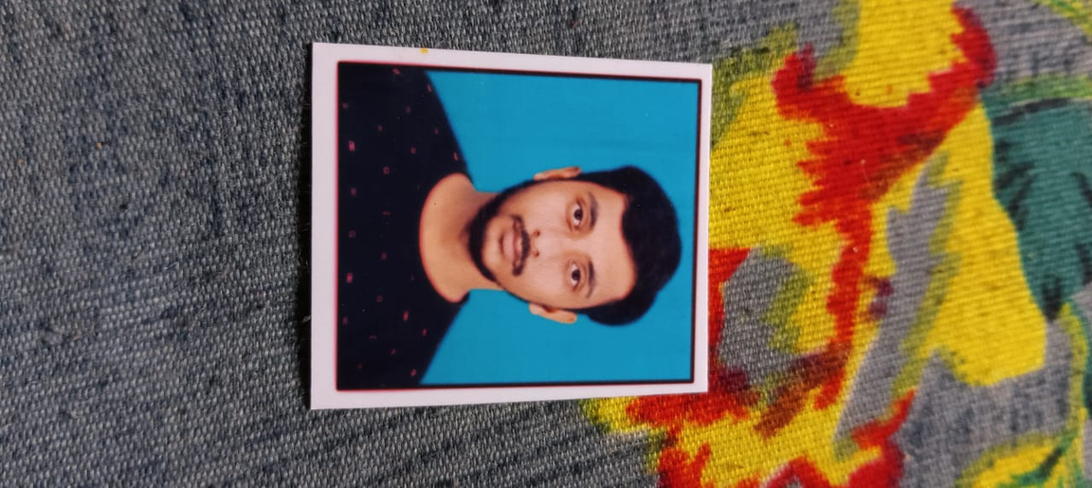



Our team
Samir Srinath
Sumit Tak
Sonu Maurya
Akash Kumar
Backend Manager
Front End Manager
Team
Team
Shweta Ray
Sheetal Kumari
Team
Team

Slide 16
Thank you
CONTACT US
sameershrinath@gmail.com
E-mail
sumitsumit53092@gmail.com
Social Media
https://github.com/Sameershrinath
https://github.com/code-with-sumit
Department
Btech CSE AIML-3B1

